Slide 1


CMR TECHNICAL CAMPUS UGC(Autonomous) Kandlakoya, Medchal Road, Hyd-501401 Department of Computer Science and Engineering A Major Project Review 1 PREDICTING URBAN WATER QUALITY WITH UBIQUITOUS DATA – A DATA DRIVEN APPROACH Batch No : 13
Group Members: Under the Guidance of :
Khaja Mubashiruddin (207R1A05L6) S. Aparna
P. Bharath Simha Reddy (207R1A05N5) Assistant Professor
Gadde Sayi Khushhal (207R1A05L0)

Slide 2
Contents :
Abstract
Existing System
Disadvantages of Existing System
Proposed System
Advantages of Proposed System
Hardware and Software Requirements
Novelty of the Project
Architecture, Modules and UML Diagrams
Results
Conclusion
Future Scope
References

Slide 3
Abstract :
Urban water quality is of great importance to our daily lives. Prediction of urban water quality helps control water pollution and protect human health.
However, predicting the urban water quality is a challenging task since the water quality varies in urban spaces non-linearly and depends on multiple factors, such as meteorology, water usage patterns, and land uses.
In this project, we forecast the water quality of a station over the next few hours from a data-driven perspective, using the water quality data and water hydraulic data reported by existing monitor stations and a variety of data sources we observed in the city, such as meteorology, pipe networks, structure of road networks, and point of interests (POIs).

Slide 4
Existing System:
Several studies in environmental science have tried to analyze water quality problems via data-driven approaches, and those studies cover a wide range of topics.
The approaches adopted in these studies include instance-based learning models (e.g., KNN) as well as neural network models (e.g., ANN).
The traditional baselines we see are ARMA, Kalman filter, and ANN Algorithms, leading to a maximum accuracy of 60%.
These traditional baselines use static data instead of real-time data as well as use only single algorithm approaches.

Slide 5
Disadvantages of Existing System:
Limited Interpretability
Data Requirement and Quality Issues
Difficulty in Capturing Complex Environmental Dynamics
Computational Resource Intensiveness and Time Consumption
Low accuracy

Slide 6
Proposed System :
Data-driven Perspective: We present a novel data-driven approach to predict the future water quality among different stations with data from multiple domains. Additionally, the approach is not restricted to urban water quality prediction but also can be applied to other multi-locations-based prediction problems in many other urban applications.
Influential Factor Identification: We identify spatially-related (such as POIs, pipe networks, and road networks) and temporally-related features (e.g., time of day, meteorology, and water hydraulics), contributing to not only our application but also the general problem of water quality prediction.
Real-time evaluation: We evaluate our method by extensive experiments that use real-world datasets in India. The results demonstrate the advantages of our method beyond other baselines, such as ARMA, Kalman filter, and ANN, and reveal interesting discoveries that can bring social good to urban life.
Multiple Algorithms: We use Logistic Regression, SVM(Support Vector Machines) and KNN algorithms to predict the water quality.

Slide 7
Advantages of proposed system :
Water quality data: We collect water quality data from many water quality monitoring stations in India. It comprises residual chlorine (RC), turbidity (TU), and pH.
In this project, we only use RC as the index for water quality, since RC is the most important and effective measurement for water quality in the current urban water distribution system.
Leading to a much-improved accuracy in predicting the water quality, approximately 78%.

Slide 8
Hardware and Software requirements :
Hardware requirements :
Processor : Pentium –IV
RAM : 4 GB (min)
Hard Disk : 20 GB
Software requirements :
Coding Language : Python.
Front-End : Html, CSS, JavaScript
Back-End : Django-ORM
Database : MySQL (XAMPP server)

Slide 9
Novelty of Project :
Multi-Station Water Quality Prediction
Cross-Domain Applicability
Real-World Dataset Evaluation
Advantages over Traditional Baselines

Slide 10
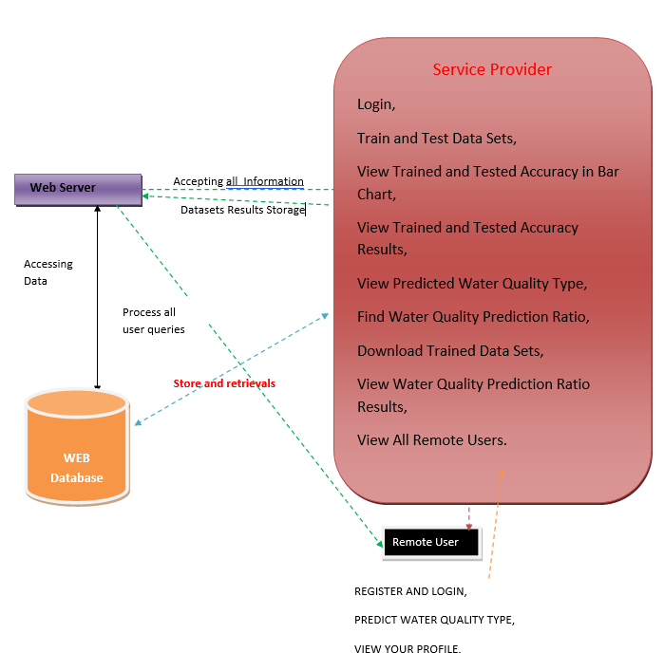
Architecture

Slide 11
Modules
Service Provider:
Remote User:
Login / Register
Train and Test Datasets
View Trained and Testes Accuracy in Bar Chart
View Predicted Water Quality type
Find Water-Quality prediction ratio
Download Trained Datasets
View water quality prediction ratio results
View all Remote users
Login / Register
Predict Water quality type
View Profile

Slide 12
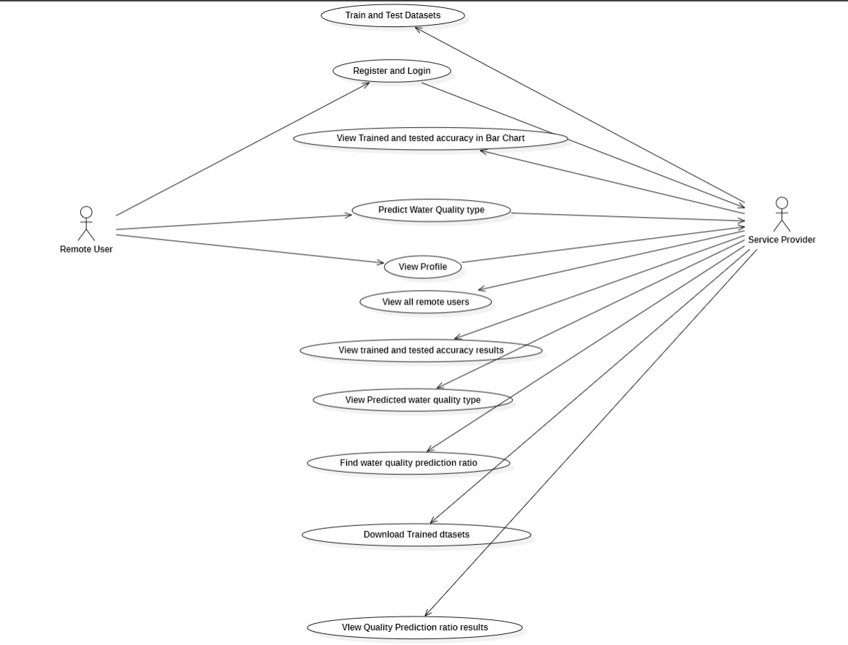
Use Case Diagram

Slide 13
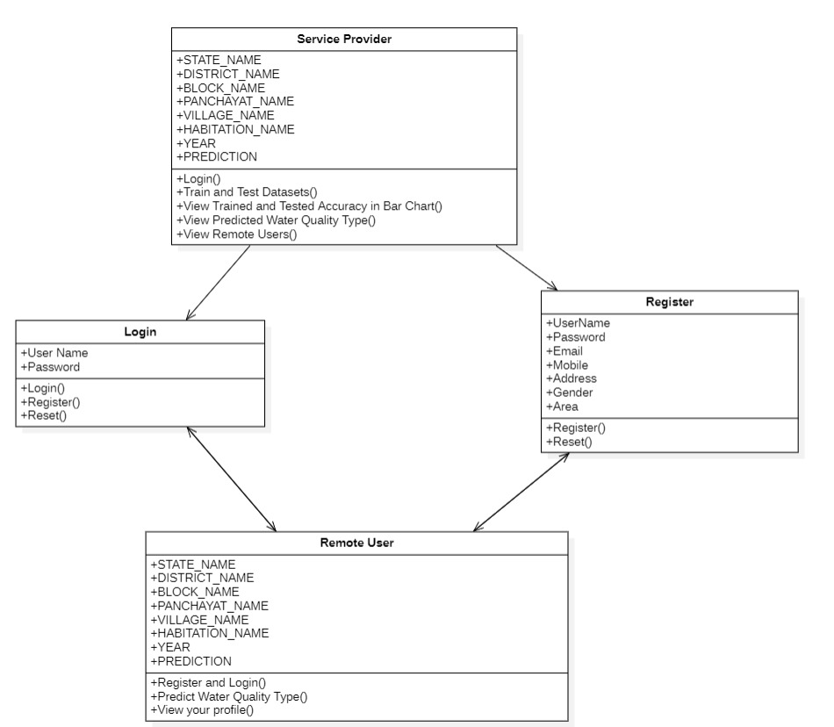
Class Diagram

Slide 14
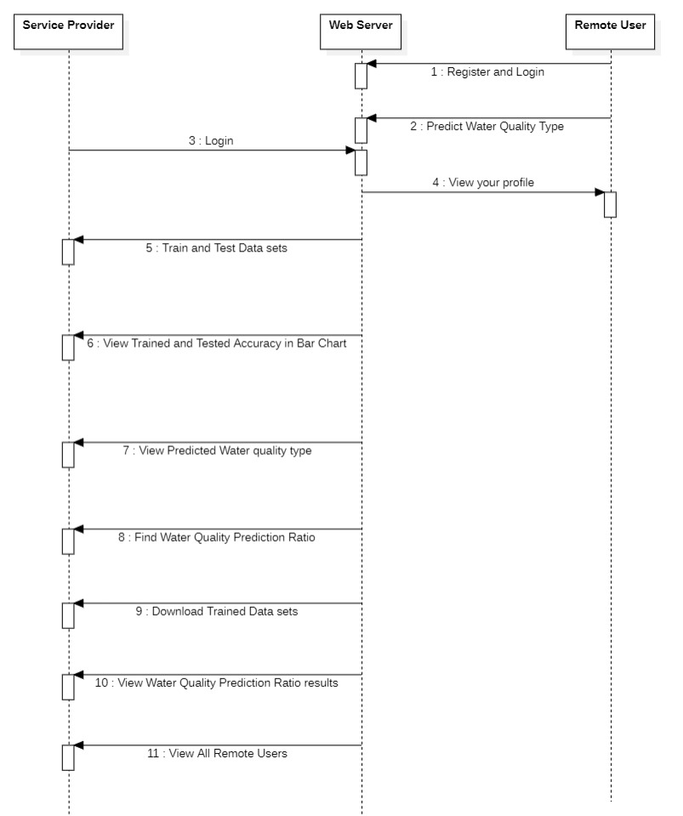
Sequence Diagram

Slide 15
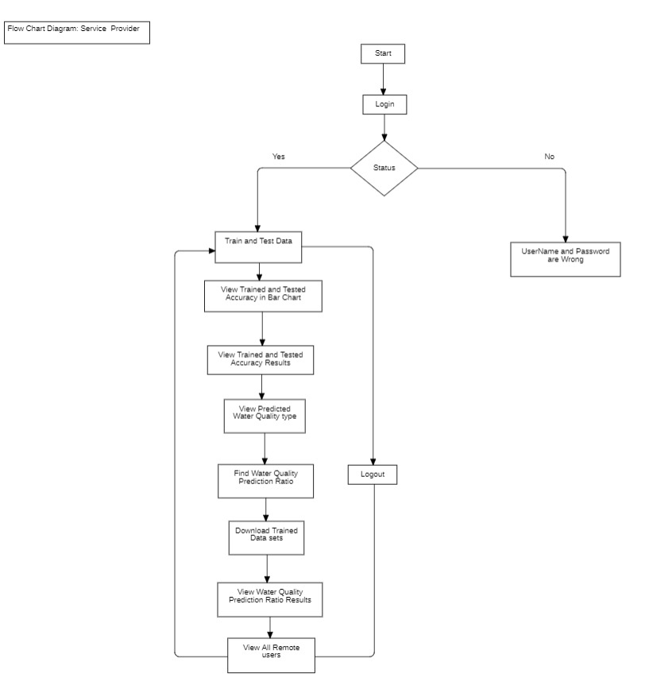
Flow Chart Diagram - Service Provider

Slide 16
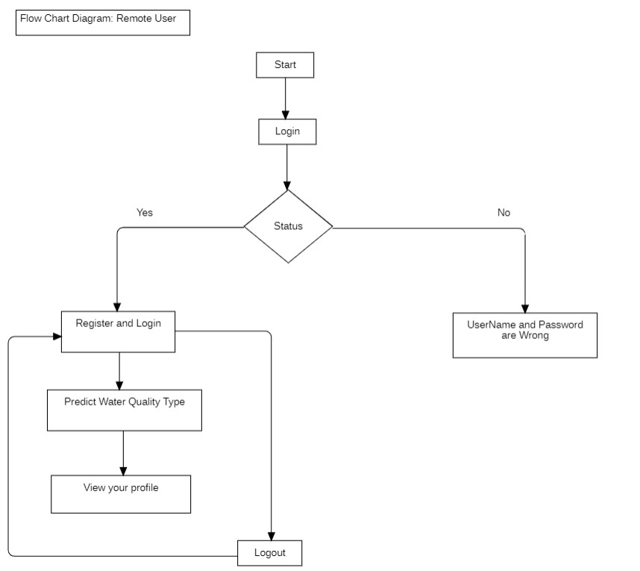
Flow Chart Diagram – Remote User

Slide 17
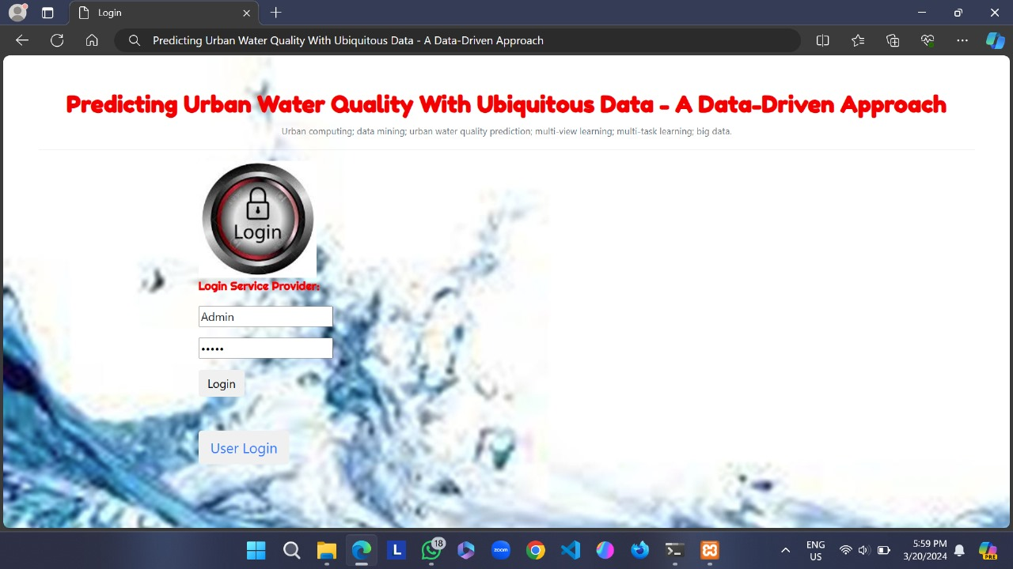
Screenshots
Screenshot-1: Login Screen for the Service Provider

Slide 18
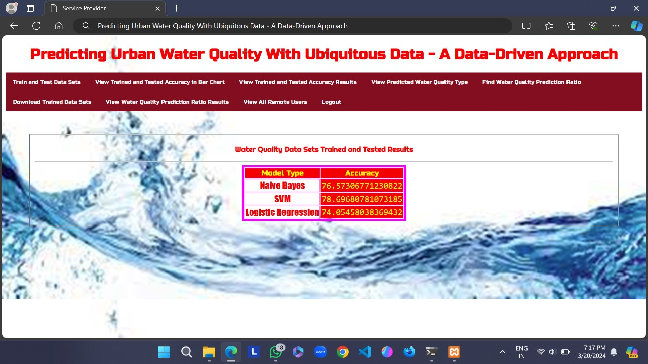
Screenshots
Screenshot-2: Results obtained after Training and testing datasets

Slide 19
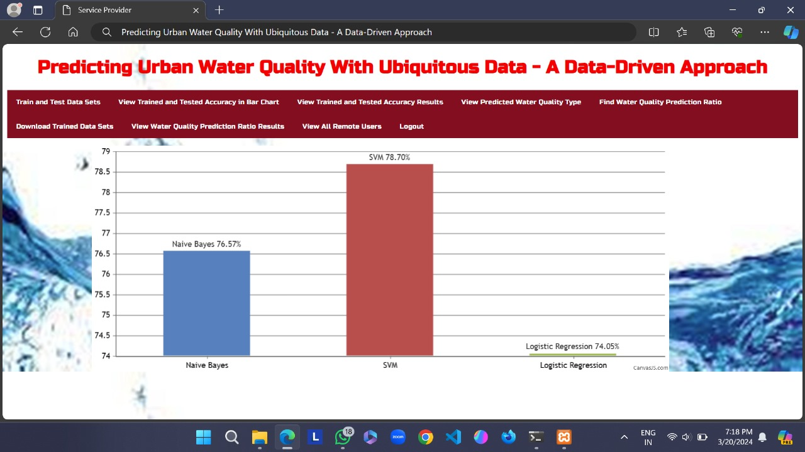
Screenshots
Screenshot-3: Trained and Tested Accuracy of algorithms in Bar Chart

Slide 20
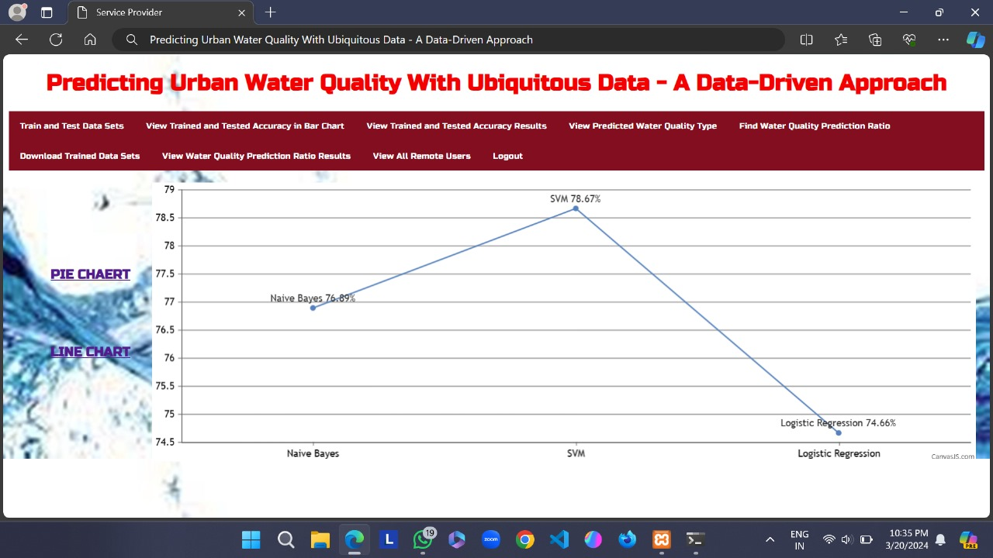
Screenshots
Screenshot-4: Trained and Tested Accuracy results in a Line-Chart

Slide 21
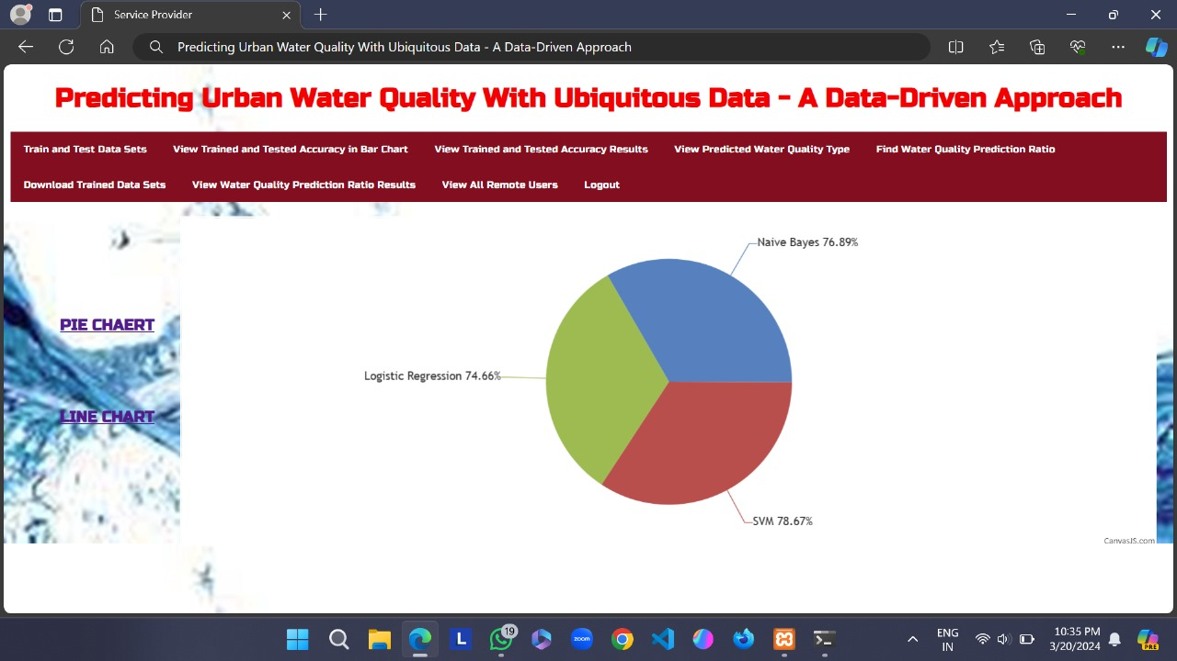
Screenshots
Screenshot-5: Trained and Tested Accuracy results in a Pie Chart

Slide 22
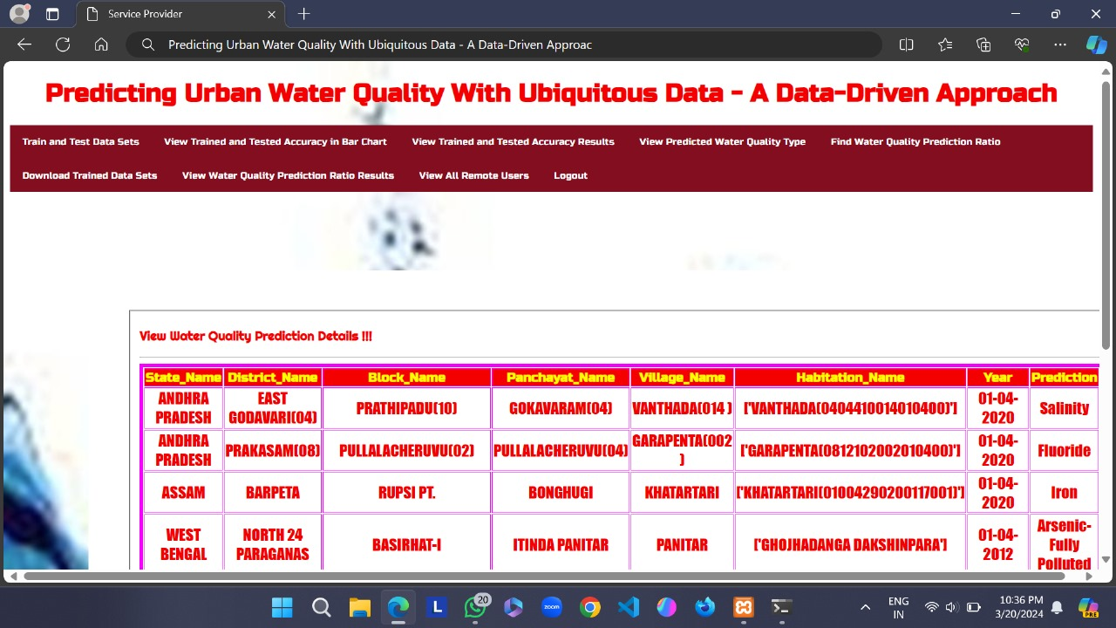
Screenshots
Screenshot-6: Predicted Water Quality type

Slide 23
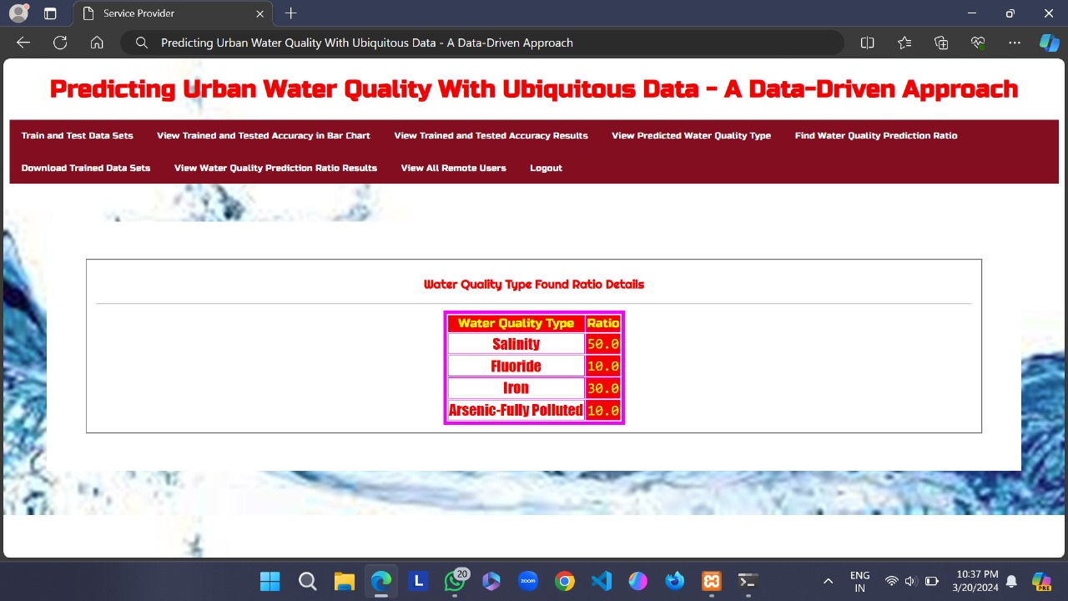
Screenshots
Screenshot-7: Water Quality type Ratio

Slide 24
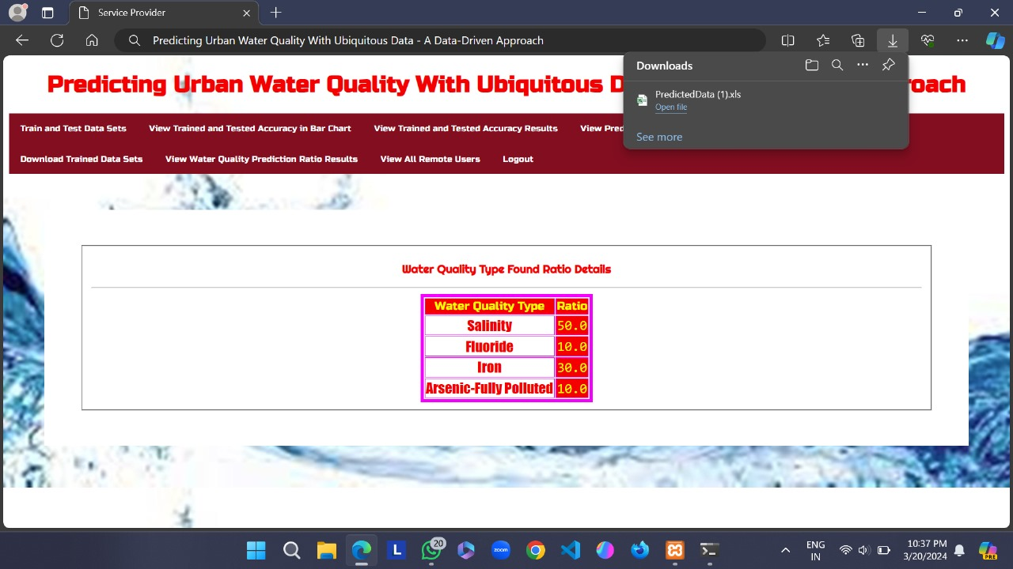
Screenshots
Screenshot-8: Downloading the Trained Datasets

Slide 25
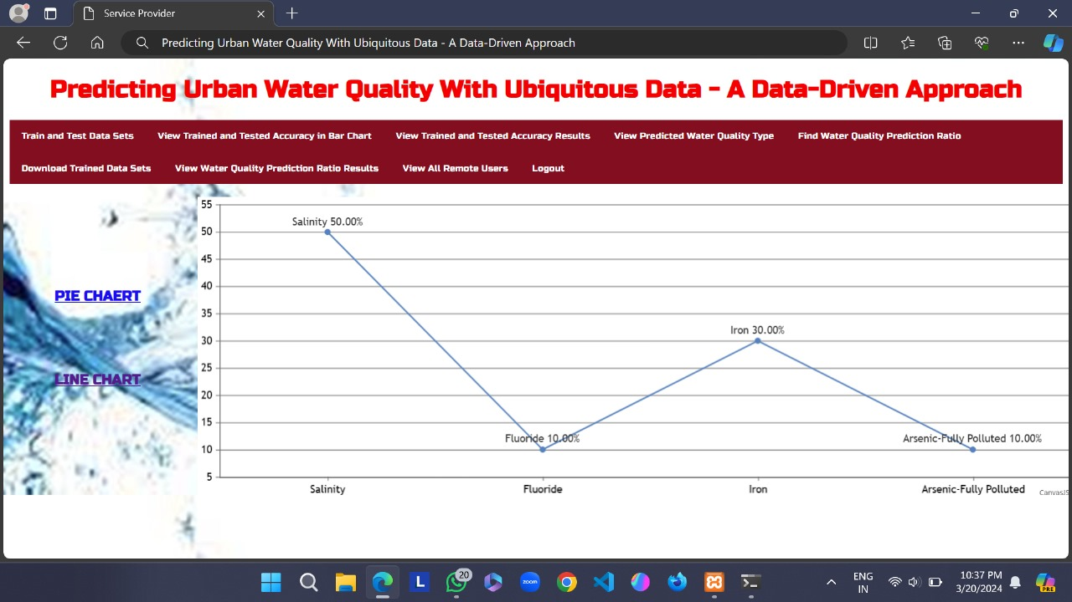
Screenshots
Screenshot-9: Water Quality prediction ratio in Line-Chart

Slide 26
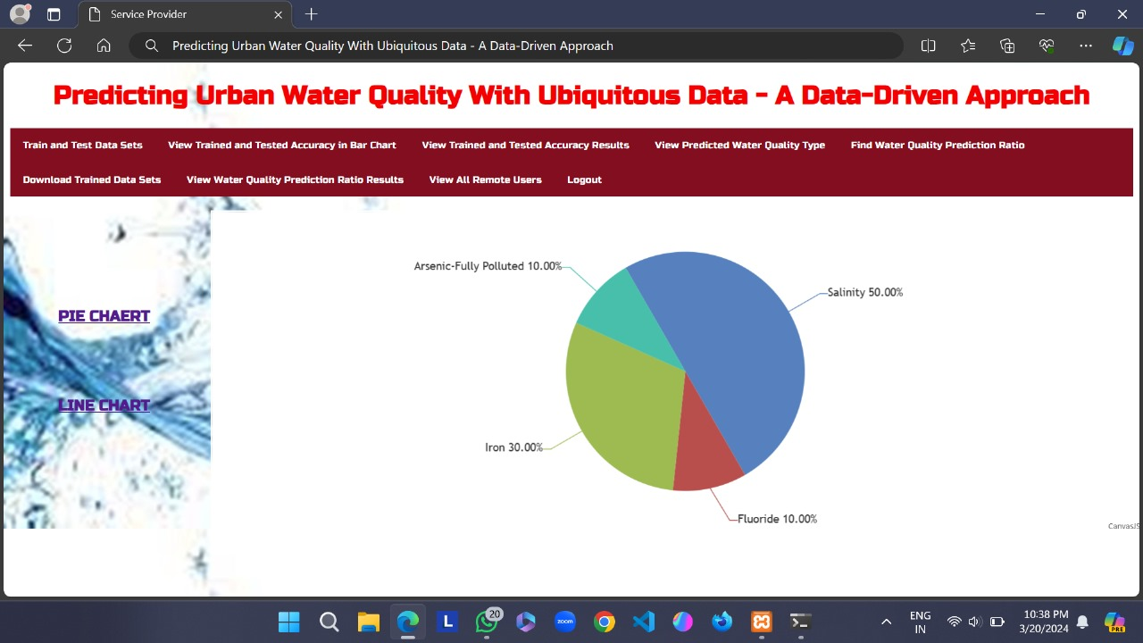
Screenshots
Screenshot-10: Water Quality prediction ratio in Pie-Chart

Slide 27
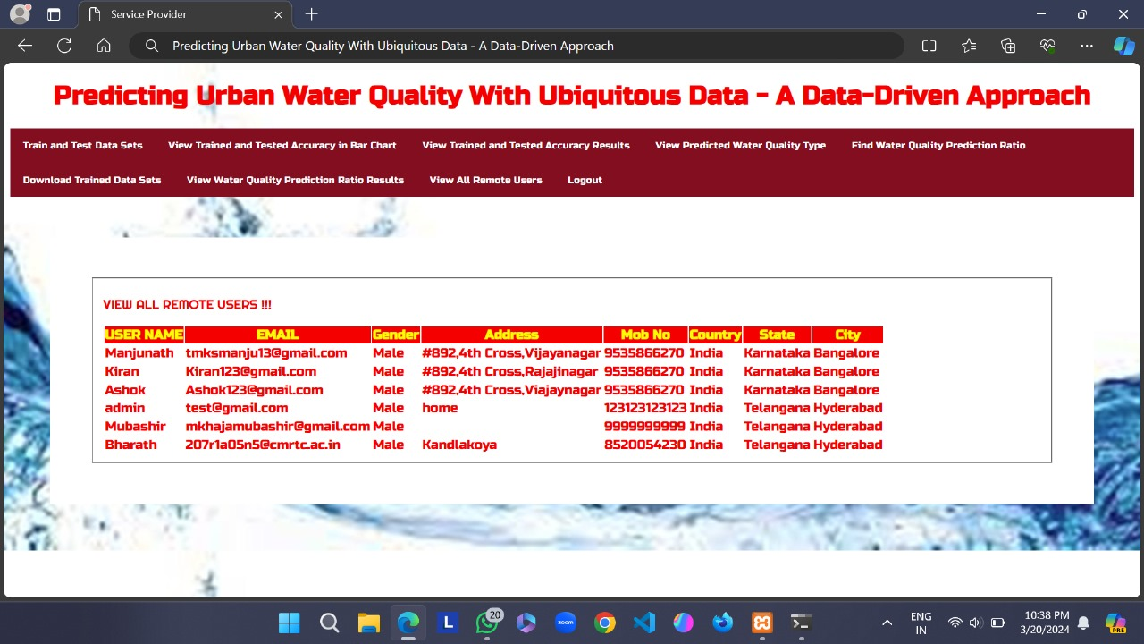
Screenshots
Screenshot-11: Viewing all Remote users

Slide 28
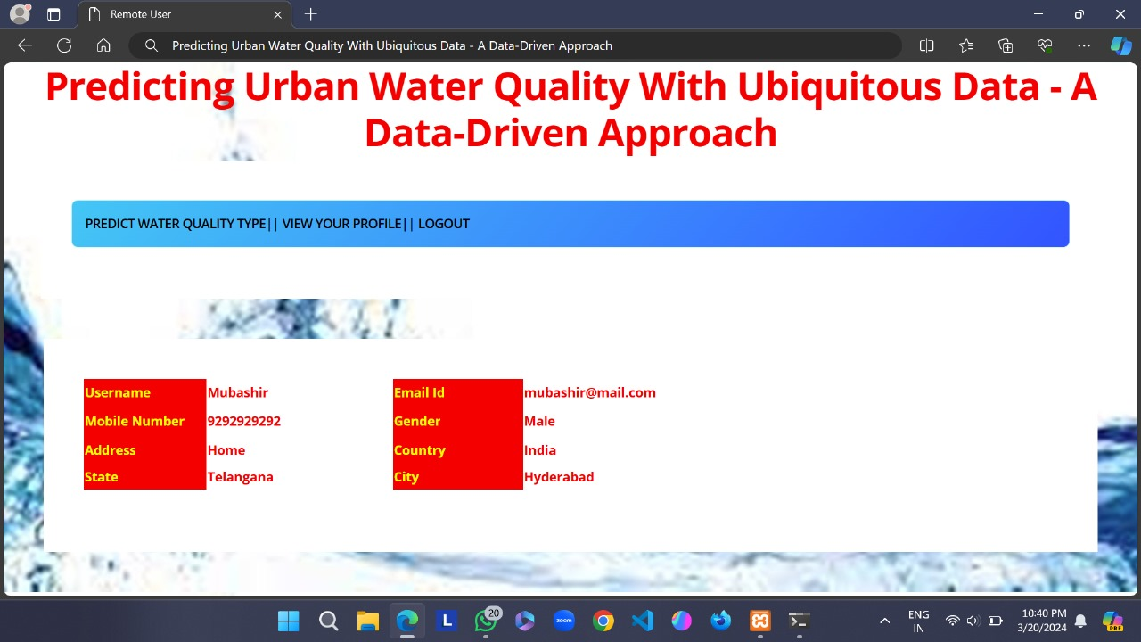
Screenshots
Screenshot-12: Remote User viewing their profile

Slide 29
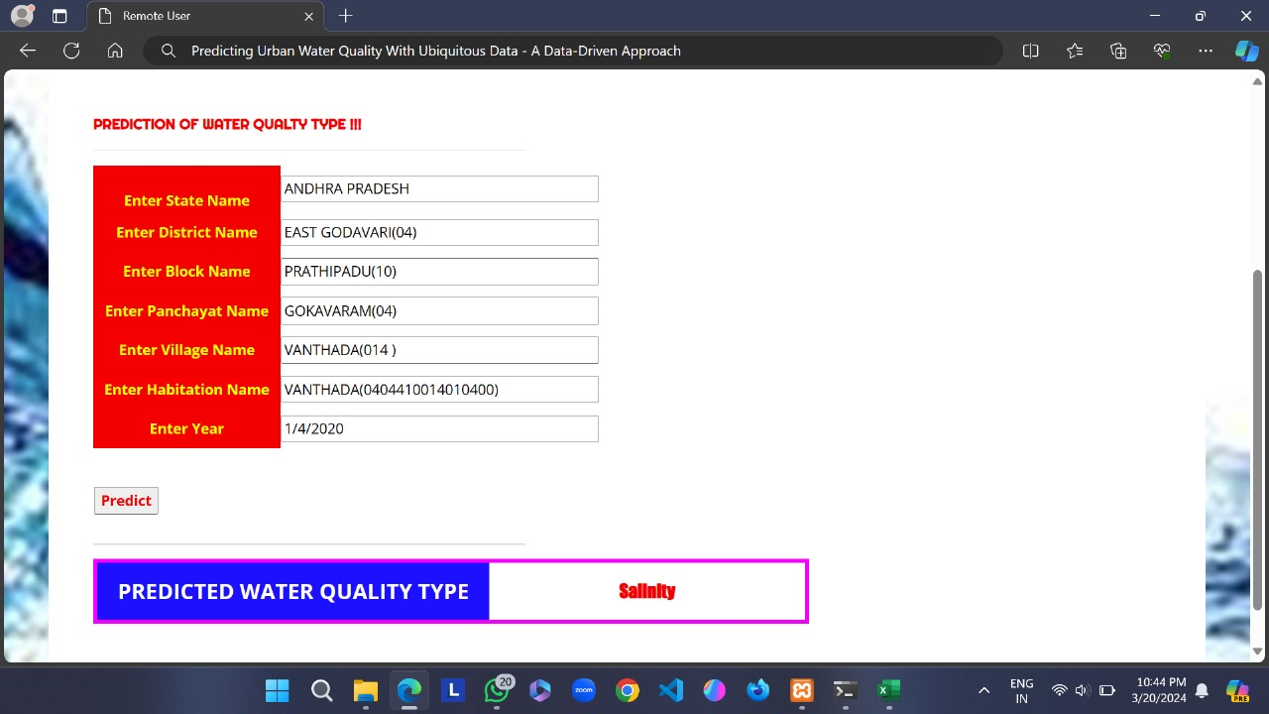
Screenshots
Screenshot-17: A Remote User entering the details to find out the Water Quality in a
particular Area

Slide 30
Sample Code
"""Django's command-line utility for administrative tasks."""
import os
import sys def main():
"""Run administrative tasks."""
os.environ.setdefault('DJANGO_SETTINGS_MODULE', 'predicting_urban_water_quality.settings')
try:
from django.core.management import execute_from_command_line
except ImportError as exc:
raise ImportError(
"Couldn't import Django. Are you sure it's installed and "
"available on your PYTHONPATH environment variable? Did you "
"forget to activate a virtual environment?"
) from exc
execute_from_command_line(sys.argv) if __name__ == '__main__':
main()

Slide 31
Sample Code
from django.db.models import Count, Avg
from django.shortcuts import render, redirect
from django.db.models import Count
from django.db.models import Q
import datetime
import xlwt
from django.http import HttpResponse
import pandas as pd
import warnings
warnings.filterwarnings("ignore")
from wordcloud import WordCloud,STOPWORDS
stopwords = set(STOPWORDS)
import re
from collections import Counter
from sklearn.metrics import classification_report,accuracy_score,confusion_matrix

Slide 32
Sample Code
# Create your views here.
from Remote_User.models import ClientRegister_Model,water_quality_type,detection_ratio,detection_accuracy
def serviceproviderlogin(request):
if request.method == "POST":
admin = request.POST.get('username')
password = request.POST.get('password')
if admin == "Admin" and password =="Admin":
detection_accuracy.objects.all().delete()
return redirect('View_Remote_Users')
return render(request,'SProvider/serviceproviderlogin.html')

Slide 33
Conclusion :
The project introduces a data-driven approach to predict future water quality across multiple stations, offering versatility beyond urban water quality prediction to various multi-location-based forecasting tasks.
By identifying related features, including points of interest, pipe networks, time of day, meteorological conditions, and water hydraulics, the methodology contributes not only to water quality prediction but also to broader urban applications.
Through comprehensive evaluations using real-world datasets from the various states in India the approach outperforms traditional baselines such as ARMA, Kalman filter, and ANN, revealing promising insights that could enhance urban life and contribute to social good.

Slide 34
Future Scope:
Integration of Advanced Machine Learning Techniques: As machine learning algorithms continue to evolve, future research can explore integrating more advanced techniques such as deep learning, ensemble methods, and reinforcement learning to further improve the accuracy and robustness of water quality prediction models. These approaches may uncover complex patterns and relationships within the data that traditional methods might overlook.
Incorporation of Big Data and IoT: With the rapid increase of IoT devices and the availability of big data, future studies can use these technologies to gather more comprehensive and real-time data on various environmental factors affecting water quality. This could include data from sensors deployed in water bodies, smart infrastructure, and even citizen science initiatives. Integrating such diverse datasets can enhance the predictive capabilities of models.
Spatial and Temporal Scalability: While the current approach considers spatial and temporal factors, there is potential to further refine the modeling techniques to account for scalability across different geographical regions and time scales. This involves developing algorithms that can adapt to varying spatial resolutions and temporal granularities, ensuring the applicability of the model to diverse urban environments and different forecasting horizons.

Slide 35
References
[1] W. H. Organization, Guidelines for drinking-water quality, 2004, vol. 3.
[2] L. A. Rossman, R. M. Clark, and W. M. Grayman, “Modeling chlorine
residuals in drinking-water distribution systems,” Journal of environmental
engineering, vol. 120, no. 4, pp. 803–820, 1994.
[3] Y. Zheng, “Methodologies for cross-domain data fusion: An overview,”
IEEE Transactions on Big Data, vol. 1, no. 1, pp. 16–34, 2015.
[4] Y. Zheng, L. Capra, O. Wolfson, and H. Yang, “Urban computing:
Concepts, methodologies, and applications,” ACM Transactions on
Intelligent Systems and Technology, vol. 5, no. 3, pp. 38:1–38:55, 2014.
[5] Y. Zheng, H. Zhang, and Y. Yu, “Detecting collective anomalies from multiple spatio- temporal datasets across different domains,” 2015.

Slide 36
References
[6] Y. Liu, Y. Zheng, Y. Liang, S. Liu, and D. S. Rosenblum, “Urban water quality prediction based on multi-task multi-view learning,” in Proceedings of the International Joint Conference on Artificial Intelligence, 2016.
[7] H. Cohen, “Free chlorine testing,” http://www.cdc.gov/safewater/chlorineresidual-
testing.html, 2014, accessed on 5 August 2016.
[8] B. D. Barkdoll and H. Didigam, “Effect of user demand on water quality
and hydraulics of distribution systems,” in Proceedings of the World Water
and Environmental Resources Congress, 2003.
[9] P. Castro and M. Neves, “Chlorine decay in water distribution systems
case study–lousada network,” Electronic Journal of Environmental,
Agricultural and Food Chemistry, vol. 2, no. 2, pp. 261–266, 2003.
[10] L. W. Mays, Water distribution system handbook, 1999.

Slide 37
Thank you!! Feel free to ask any questions.

